Slide 1
Manual GR using Minimal API
Sowmya

Slide 2
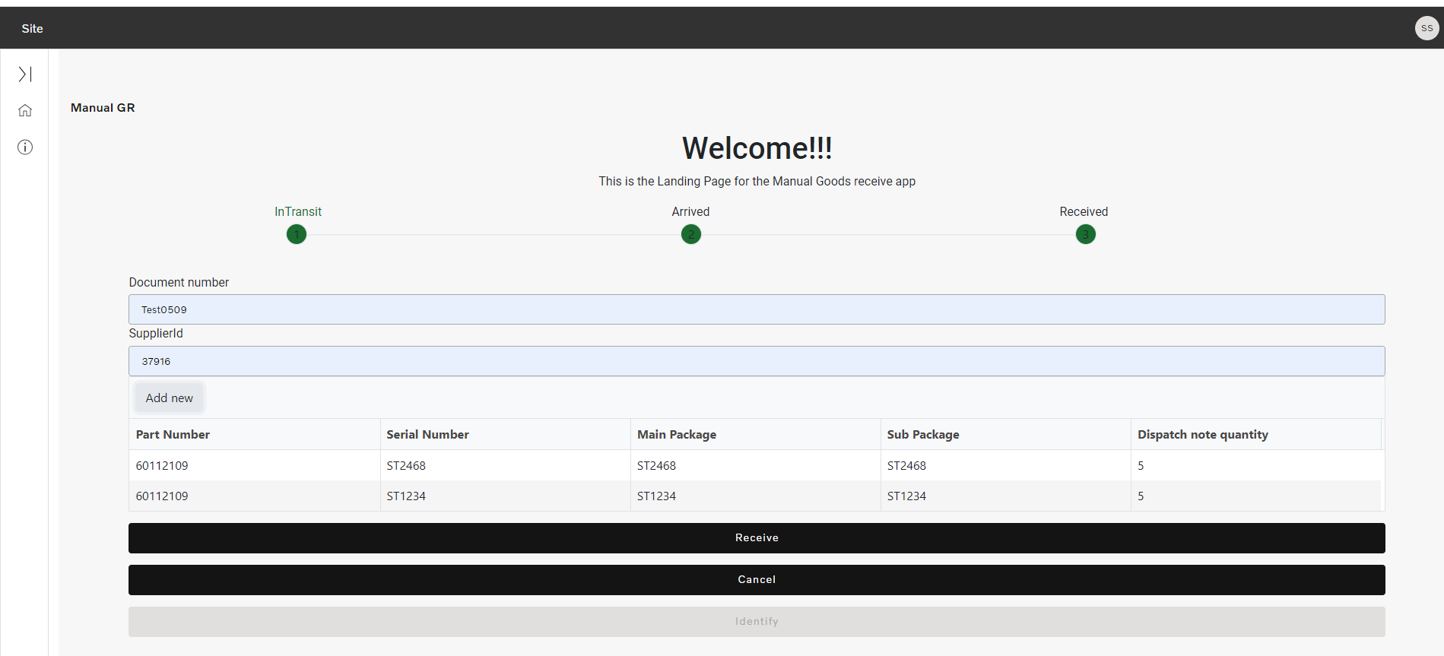

Slide 3
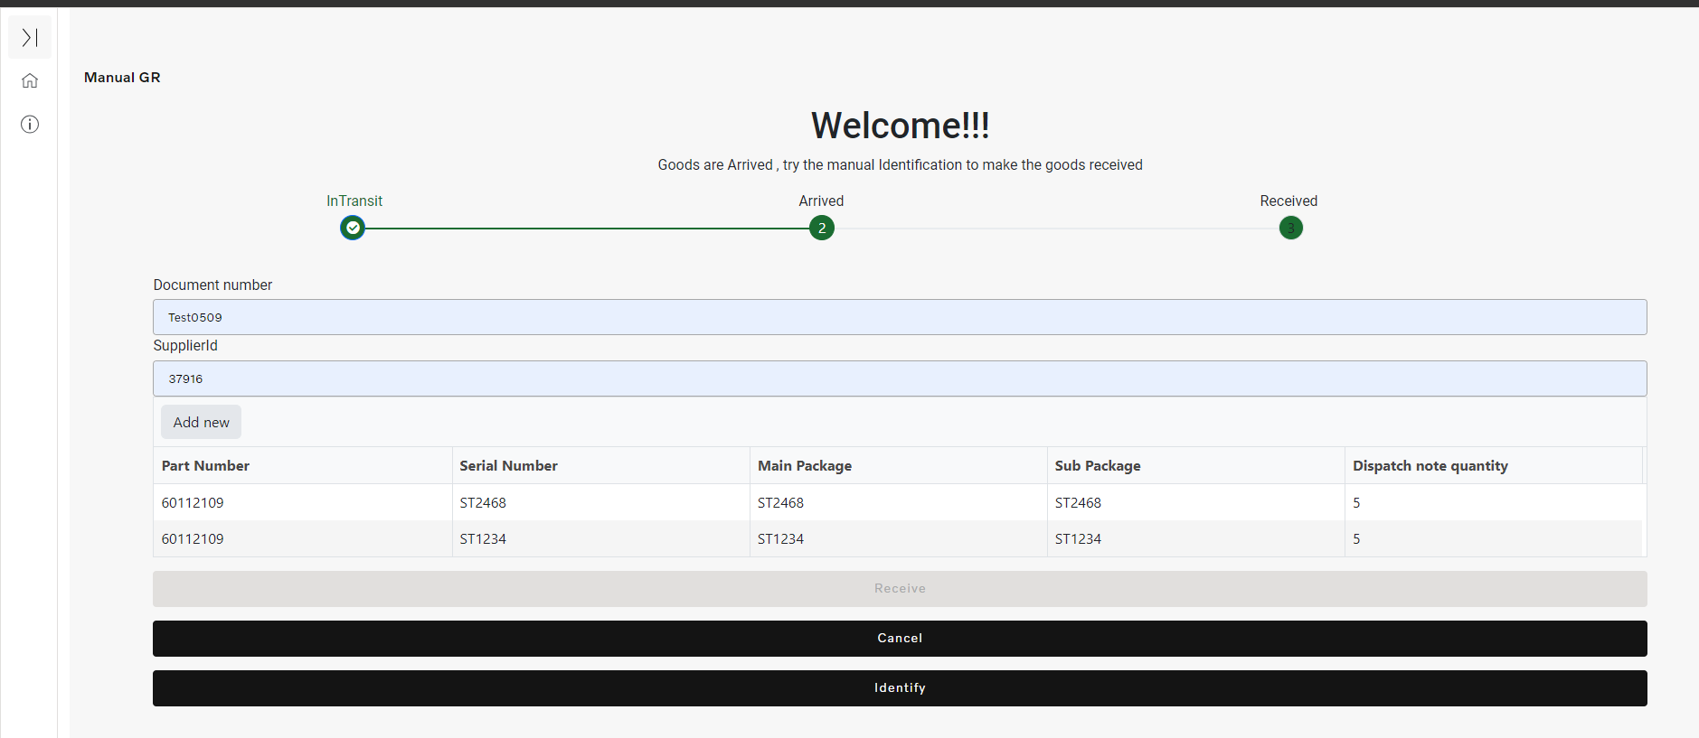

Slide 4


Slide 5
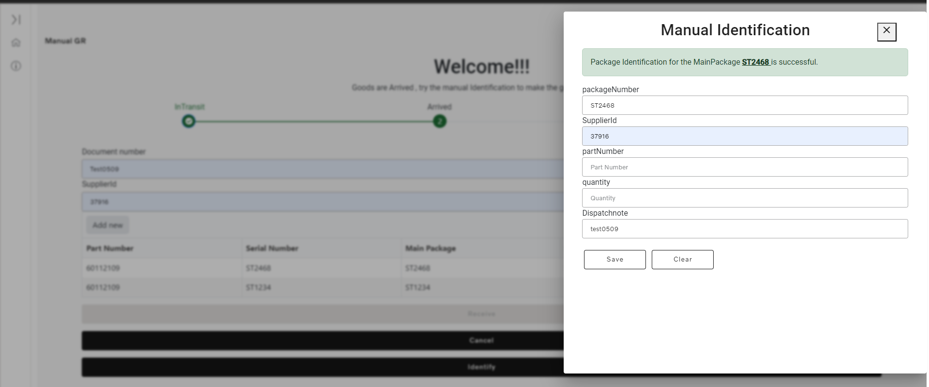

Slide 6



Slide 7
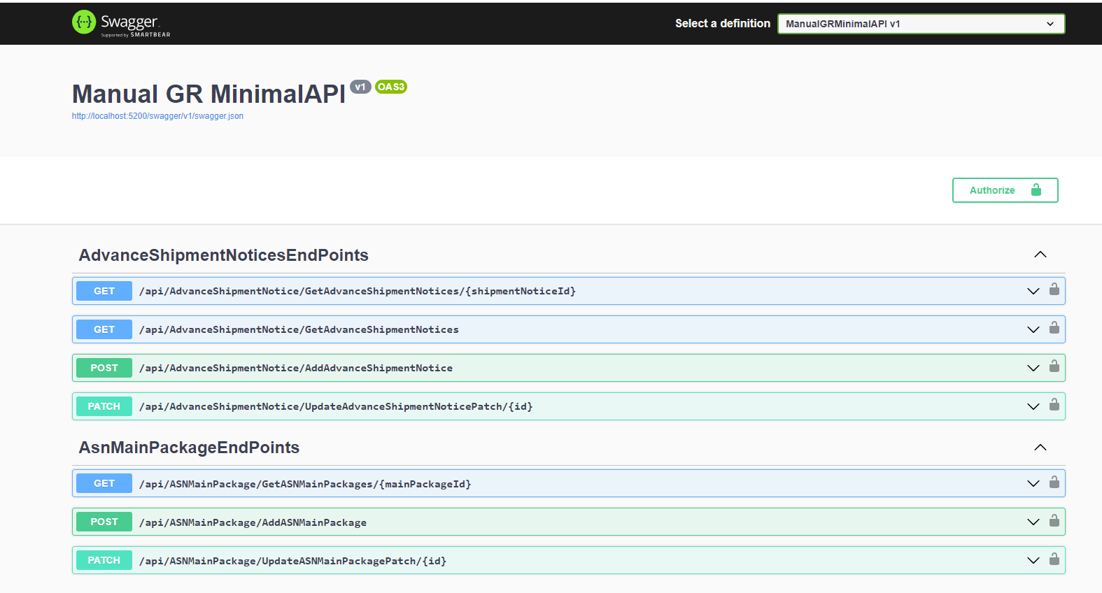
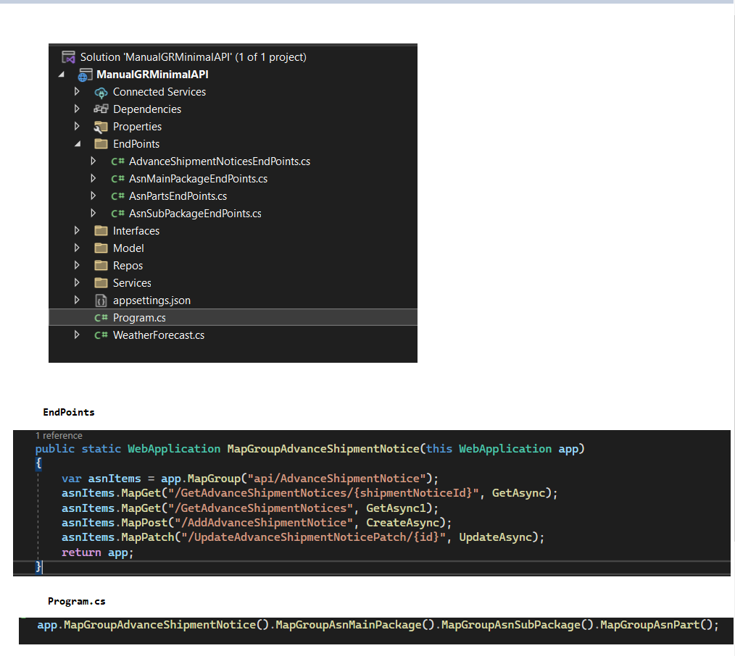
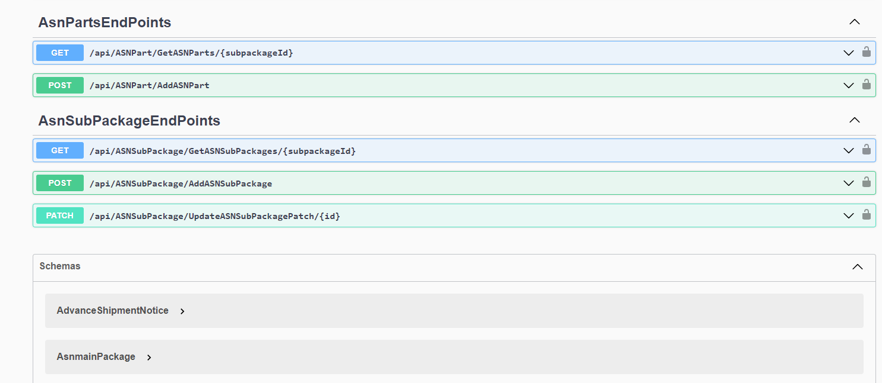

Slide 8
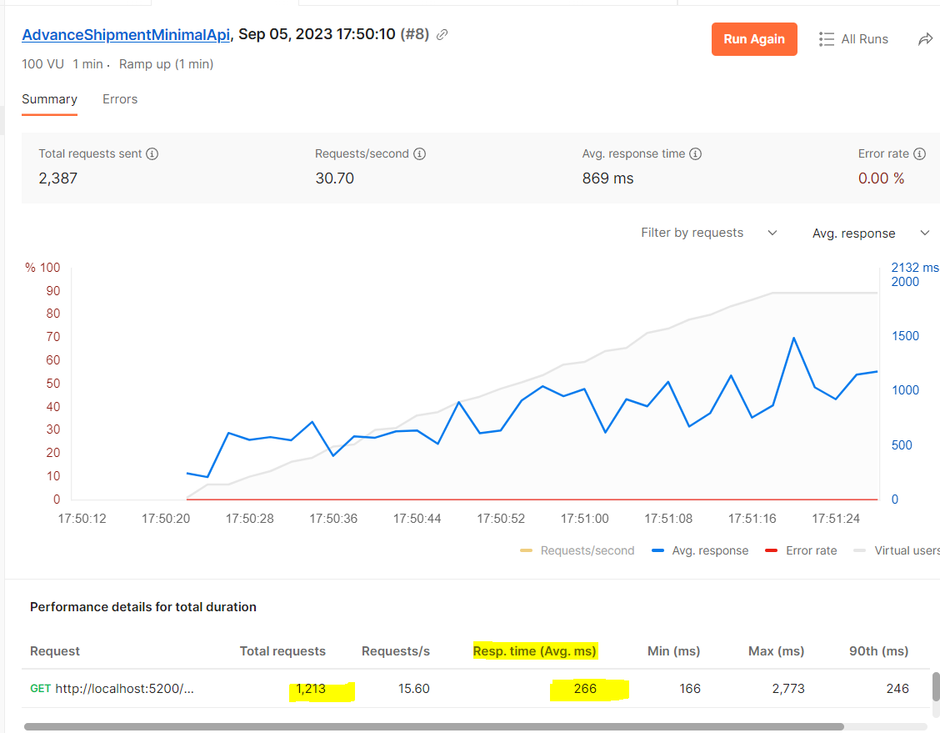
Minimal API Performance rate:
If you notice Average time slightly lesser here with the minimal API than time shown in next screen which is controller-based API.

Slide 9
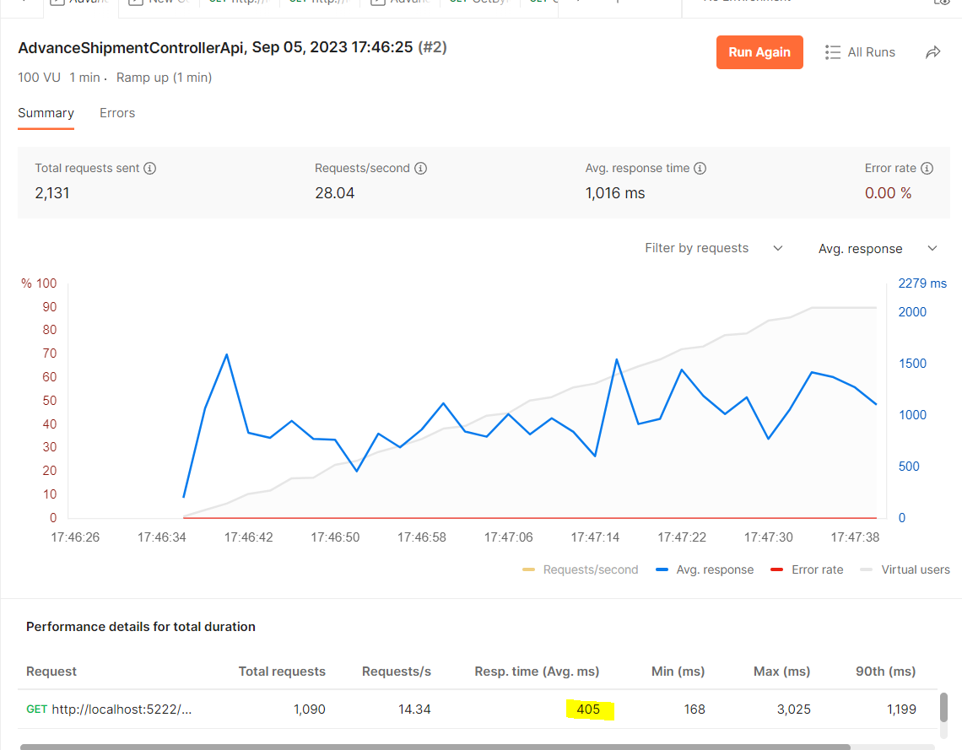
Controller API Performance rate

Slide 10
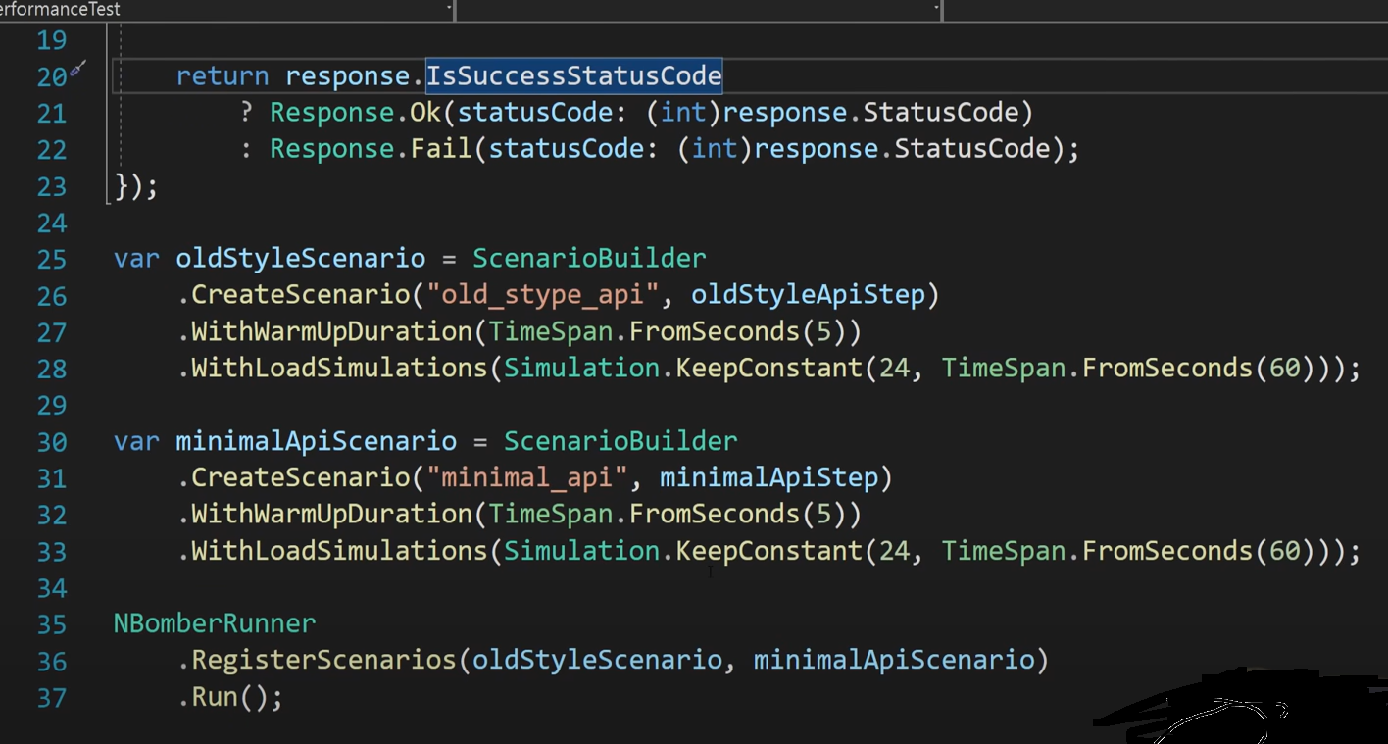

Slide 11
